Slide 1
ABELE Image Explainer
XAI course 2021/2022
Trenta Alessandro

Slide 2
ABELE – Model description
Local: it generates explanations of an image based on its neighborhood obtained with a generative algorithm.
Black-box model: the predictor is treated as a black-box
Based on the usage of an adversarial autoencoder.
Neighborhood found in the latent space of the autoencoder: using features/concepts instead of pixels.
Generates a decision tree in the latent space neighborhood to generate explanations.

Slide 3
ABELE – Process and outputs
ABELE generates a neighborhood in the latent space using a generative algorithm.
A decision tree on the latent space is generated for label prediction using the black box.
Using the decision tree and the decoder of our network ABELE generates a saliency map, exemplars and counterexemplars.

Slide 4
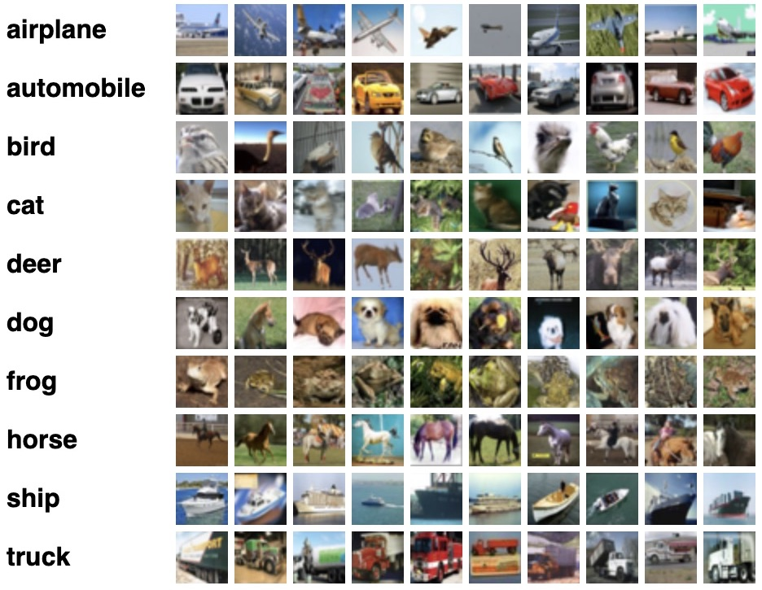
Cifar10 dataset
50000 train images, 10000 test images
32x32 pixel colored images

Slide 5
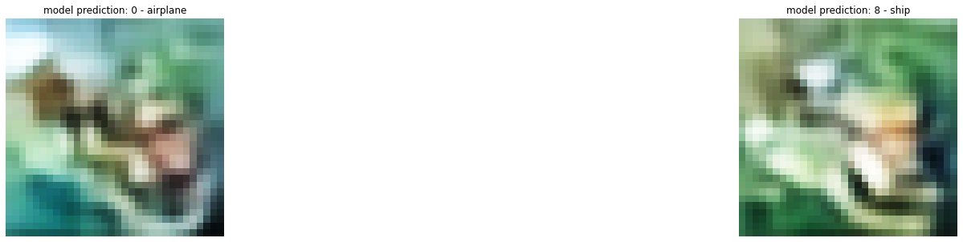
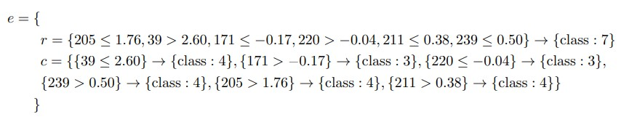
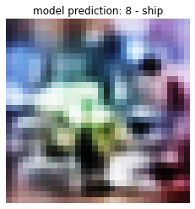
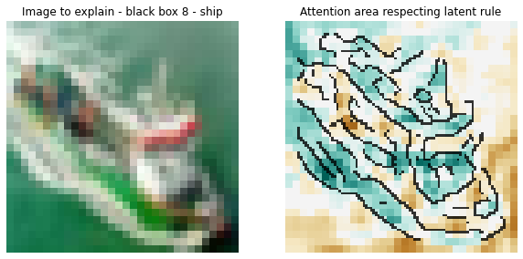
Example outputs
Counterexemplars
Decision tree explanatory rule
Prototypes
Saliency map

Slide 6
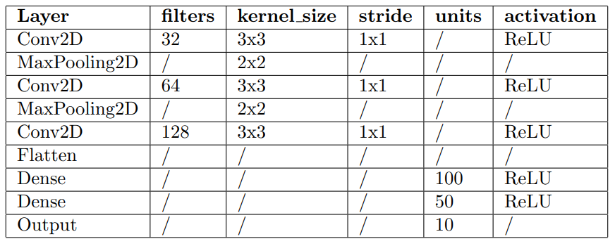
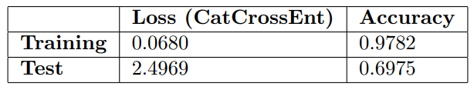
The Black Box
Description
Structure
Convolutional Neural Network
3 Conv2D layers, then 2 dense layers
50 epochs
Batch size: 128
Loss: categorical cross entropy
Metrics: accuracy

Slide 7
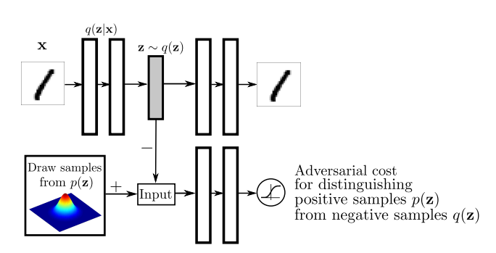
Adversarial Autoencoder (AAE)
Similar to Variational Autoencoder (VAE).
Encoder – decoder network with an additional discriminator network.
Given x input, z its latent representation we want p(z|x) to match a Gaussian N(0,1) distribution.
In VAEs this is done via information theory.
In AAEs this is done in a generative way where the encoder plays the role of the generator

Slide 8
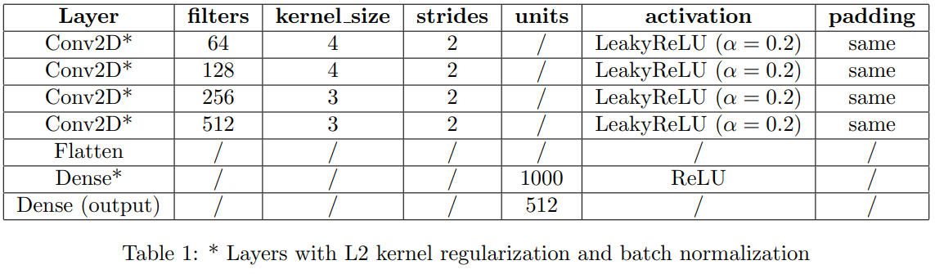
AAE
Description
Structure
Encoder network is a deep CNN with 4 Conv2D layers and 2 dense layers.
Decoder network is the symmetric
Discriminator network is a FCNN with 2 dense layers.
149 epochs
Batch size: 256
Latent dimension: 256
Discrimnator: 2 dense layers of 200 units with
L2 kernel regularization and ReLU activation

Slide 9
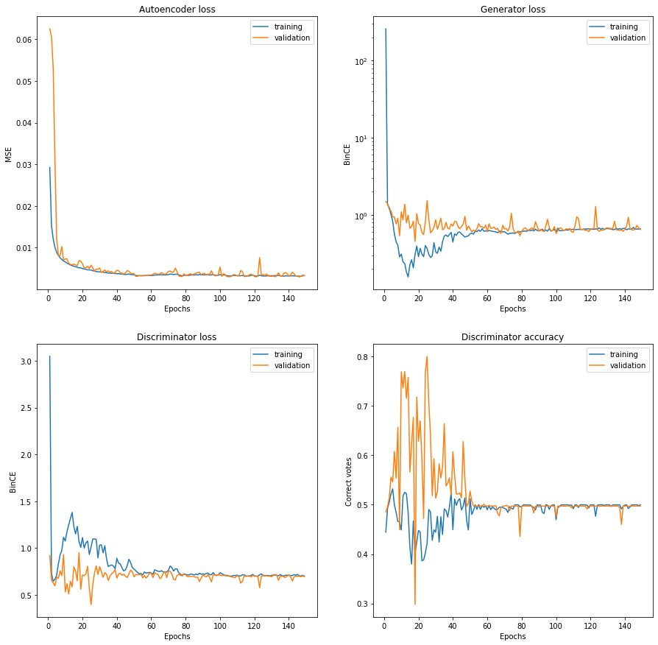
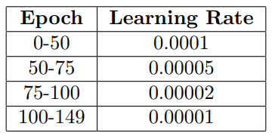
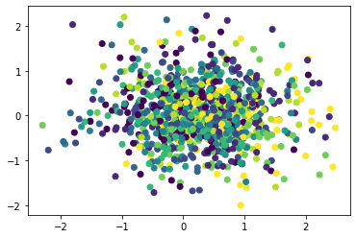
AAE - training

Slide 10
Analysis and results
We are going to look at some example image prediction using ABELE:
Decision tree explainatory rules are omitted due to lack of interpretability.
ABELE gives us the decision tree prediction and the fidelity of the decision tree in the neighborhood
Fidelity is defined as the ratio of correct decision tree predictions matching the black box prediction.
The latent space dimension is high, therefore the prototypes appear to be confused. We are going to omit them unless relavant.

Slide 11
Example 1 – ship – fidelity 64%
Saliency map showing the black box is working well
Second counterexemplar similar to original image
First counterexemplar has different background color

Slide 12
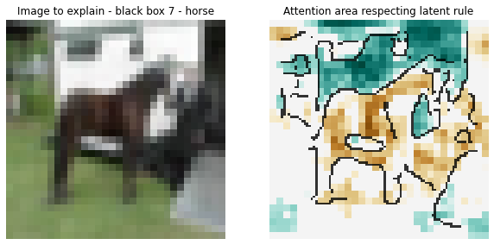
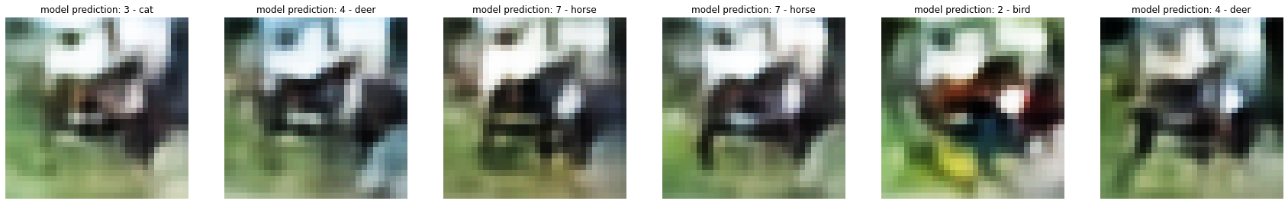
Example 2 – horse – fidelity 90%
Black box is predicting correctly but not focusing on the horse itself.
Counterexemplars are all animals.

Slide 13
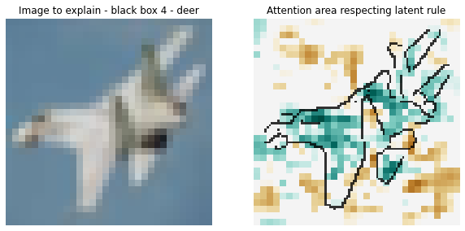
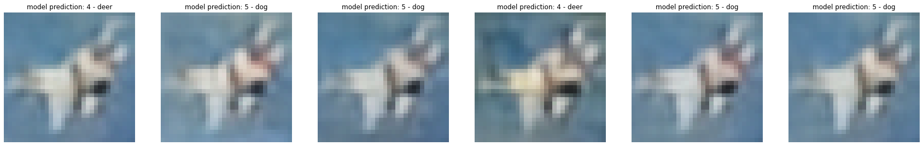
Example 3 – airplane – fidelity 64%
Wrong prediction
The attention area is correctly identified.
All counterexemplars are still animals.

Slide 14
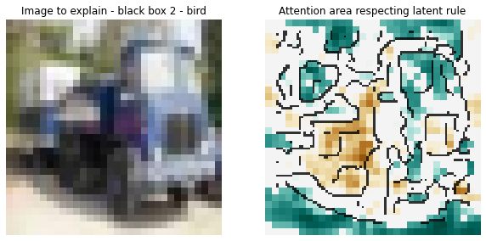
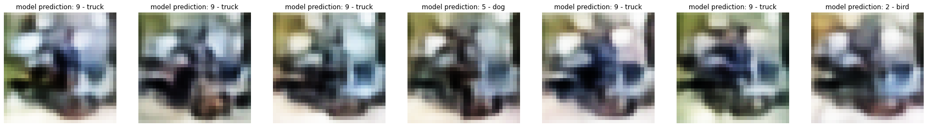
Example 4 – truck – fidelity 95%
Black box AND decision tree predict a bird.
Blue points are mostly in the background and floor.
Most counterexemplars are predicted correctly.
Some of them are animals.
Complex neighborhood?

Slide 15
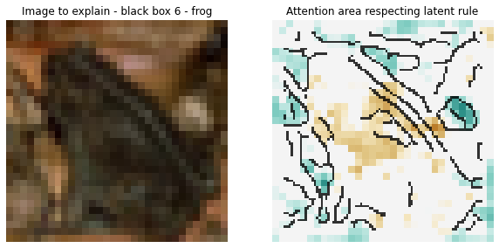
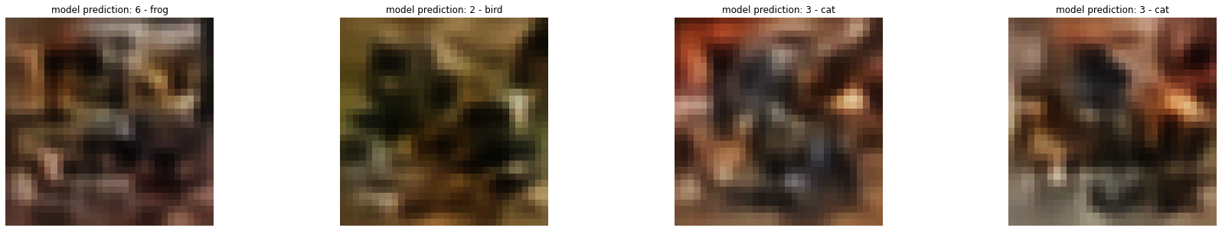
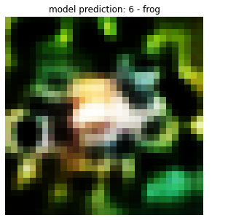
Example 5 – frog – fidelity 70%
Same issue as before
Interesting prototype.
Confused counterexemplars but all animals

Slide 16
Final remarks
Saliency maps and counterexemplars are the most meaningful and interpretable outputs.
It can show the black box is not following the right patterns.
High reconstruction error and a not so powerful AAE lead to confused image.
Prototypes are not human-undestandable for high latent dimensions.
Without a clear understaning of latent space variables the explainatory rules and the decision tree are not interpretable.
Low fidelity may indicate bad interpretations.
Slow to get results.
The algorithm doesn’t produce outputs every time.

Slide 17
Thank you!

